Slide 2
develop understanding about basics of stream, upstream and downstream,
derive important facts and formulae relating to various problems on boats and streams,

Slide 3
Basics, Important Facts & Formulae
Still Water
  Speed of Water (River) - Zero
Stream
  Moving Water – River
Given Speed of a Boat/Swimmer - Speed in Still Water

Slide 4
Basics, Important Facts & Formulae
Upstream
  Boat/Swimmer - Against Stream (Flow of River)
  Direction - Opposite to Direction of Stream
Flow of River
Boat/Swimmer

Slide 5
Basics, Important Facts & Formulae
Downstream
  Boat/Swimmer – With Stream (Flow of River)
  Direction - Along Direction of Stream
Flow of River
Boat/Swimmer

Slide 6
Important Facts & Formulae
If the speed of a boat/swimmer be ‘a’ Km/h and the speed of a stream/current be ‘b’ Km/h, then
Downstream Speed of Boat/Swimmer,
x = (a + b) Km/h
Upstream Speed of Boat/Swimmer,
y = (a - b) Km/h

Slide 7
Important Facts & Formulae
Suppose a man can swim in still water at the rate of ‘a’ Km/h, the speed of current/stream is ‘b’ Km/h, and the man wishes to cross the stream (of width ‘d’ m) straight along its width, then time taken to cross the river is the same as time taken to swim ‘d’ m at ‘a’ km/hr.

Slide 8
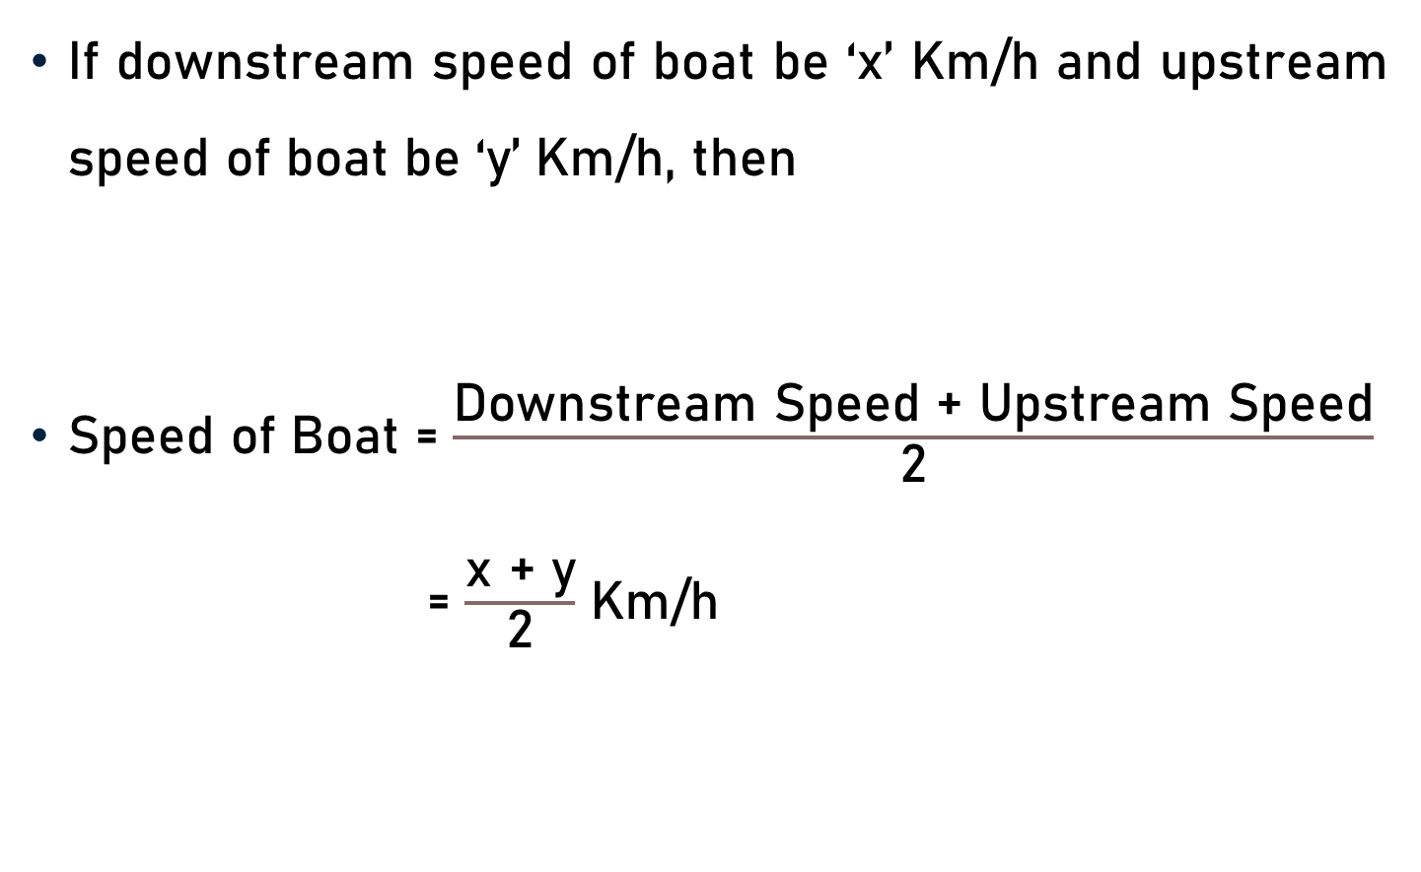
Important Facts & Formulae
If downstream speed of boat be ‘x’ Km/h and upstream speed of boat be ‘y’ Km/h, then
Speed of Boat = $\frac{\text{Downstream} \text{Speed}\text{ + }\text{Upstream} \text{Speed}}{\text{2}}$
= $\frac{\text{x}\text{ + }\text{y}}{\text{2}}$ Km/h

Slide 9
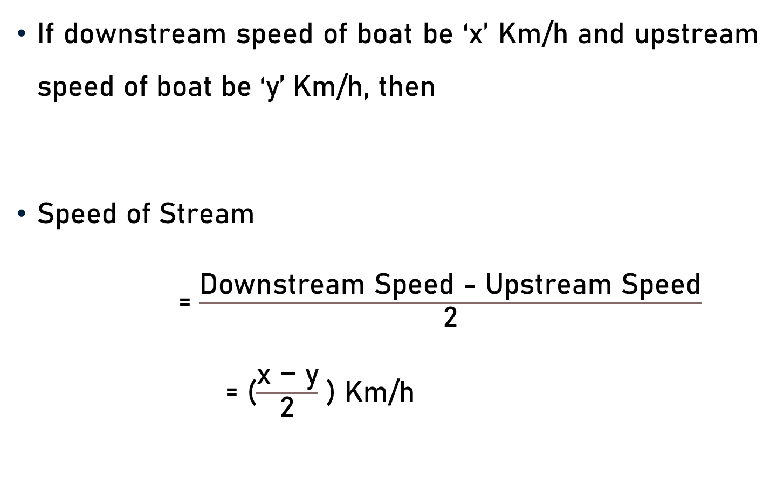
Important Facts & Formulae
If downstream speed of boat be ‘x’ Km/h and upstream speed of boat be ‘y’ Km/h, then
Speed of Stream
= $\frac{\text{Downstream} \text{Speed}\text{ − }\text{Upstream} \text{Speed}}{\text{2}}$
= ($\frac{\text{x} \text{−} \text{y}}{\text{2}}$ ) Km/h

Slide 10
Important Facts & Formulae
If speed of a boat be ‘a’ Km/h, speed of a stream be ‘b’ Km/h, downstream speed of boat be ‘x’ Km/h, and upstream speed of boat be ‘y’ Km/h, then
Downstream Speed of Boat,
x = (a + b) Km/h ….. (1)
Upstream Speed of Boat
y = (a - b) Km/h …… (2)
Downstream Speed + Upstream Speed = (a + b)+(a - b)

Slide 11
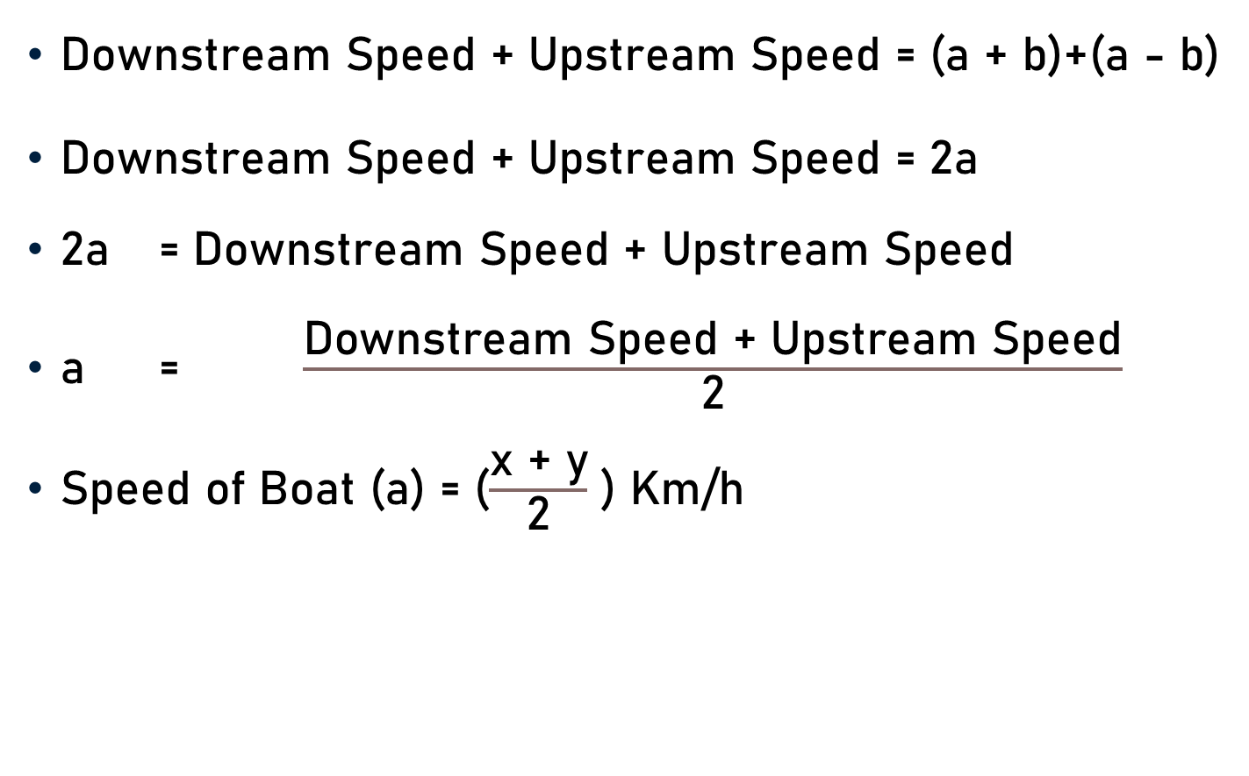
Important Facts & Formulae
Downstream Speed + Upstream Speed = (a + b)+(a - b)
Downstream Speed + Upstream Speed = 2a
2a = Downstream Speed + Upstream Speed
a = $\frac{\text{Downstream} \text{Speed}\text{ + }\text{Upstream} \text{Speed}}{\text{2}}$
Speed of Boat (a) = ($\frac{\text{x}\text{ + }\text{y}}{\text{2}}$ ) Km/h

Slide 12
Important Facts & Formulae
If speed of a boat be ‘a’ Km/h, speed of a stream be ‘b’ Km/h, downstream speed of boat be ‘x’ Km/h, and upstream speed of boat be ‘y’ Km/h, then
Downstream Speed of Boat, x = (a + b) Km/h ….. (1)
Upstream Speed of Boat, y = (a - b) Km/h …… (2)
Downstream Speed - Upstream Speed = (a + b)-(a - b)

Slide 13
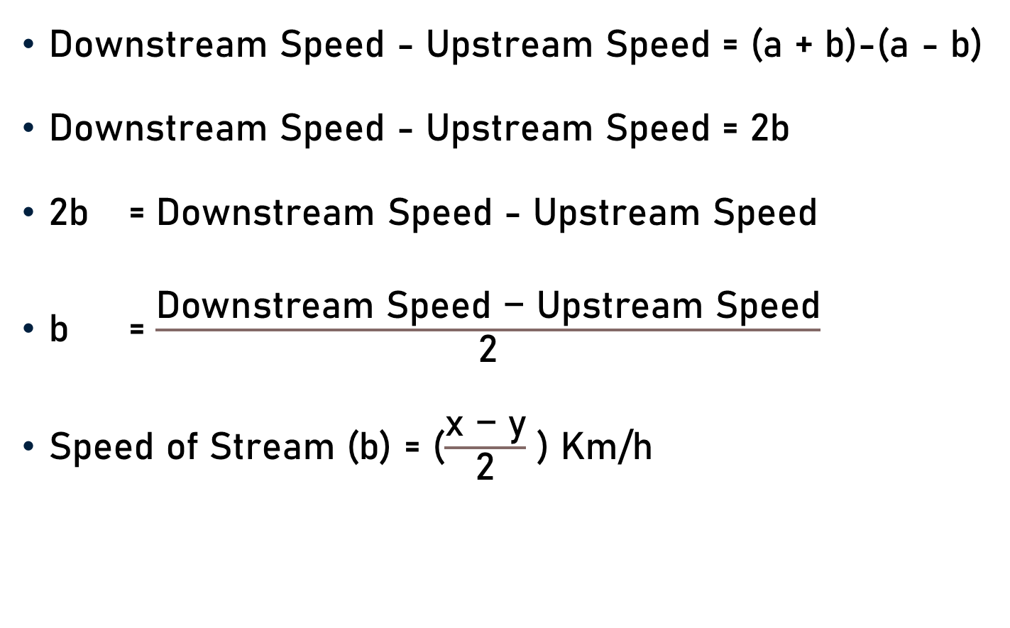
Important Facts & Formulae
Downstream Speed - Upstream Speed = (a + b)-(a - b)
Downstream Speed - Upstream Speed = 2b
2b = Downstream Speed - Upstream Speed
b = $\frac{\text{Downstream} \text{Speed}\text{ − }\text{Upstream} \text{Speed}}{\text{2}}$
Speed of Stream (b) = ($\frac{\text{x}\text{ − }\text{y}}{\text{2}}$ ) Km/h

Slide 14
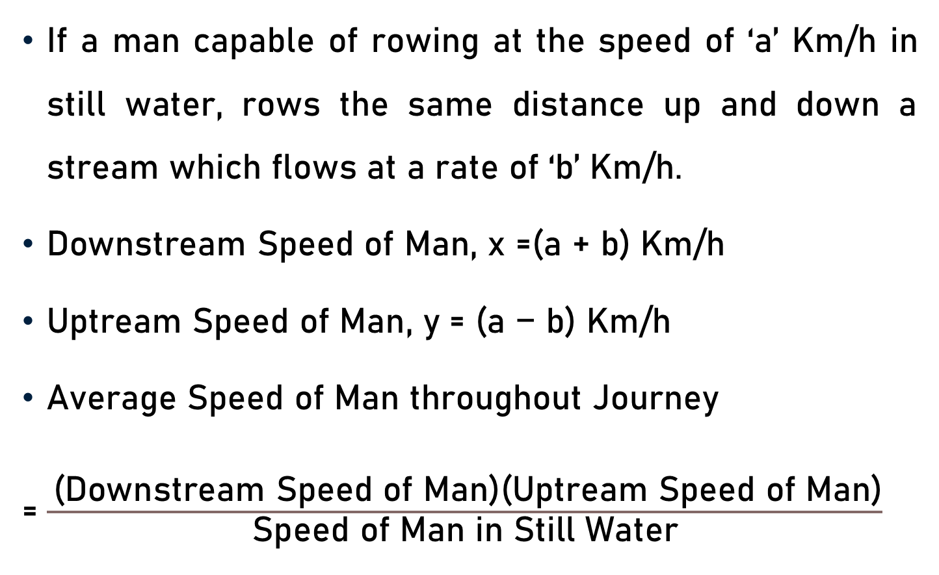
Important Facts & Formulae
If a man capable of rowing at the speed of ‘a’ Km/h in still water, rows the same distance up and down a stream which flows at a rate of ‘b’ Km/h.
$\text{Downstream} \text{Speed} \text{of} \text{Man}\text{, }\text{x}$ =$\text{(}\text{a}\text{ + }\text{b}\text{)}$ Km/h
$\text{Uptream} \text{Speed} \text{of} \text{Man}$, y = $\text{(}\text{a} \text{−} \text{b}$) Km/h
Average Speed of Man throughout Journey
= $\frac{ \text{(}\text{Downstream} \text{Speed} \text{of} \text{Man}\text{)(}\text{Uptream} \text{Speed} \text{of} \text{Man}\text{)}}{\text{Speed} \text{of} \text{Man} \text{in} \text{S}\text{till} \text{W}\text{ater}}$

Slide 15
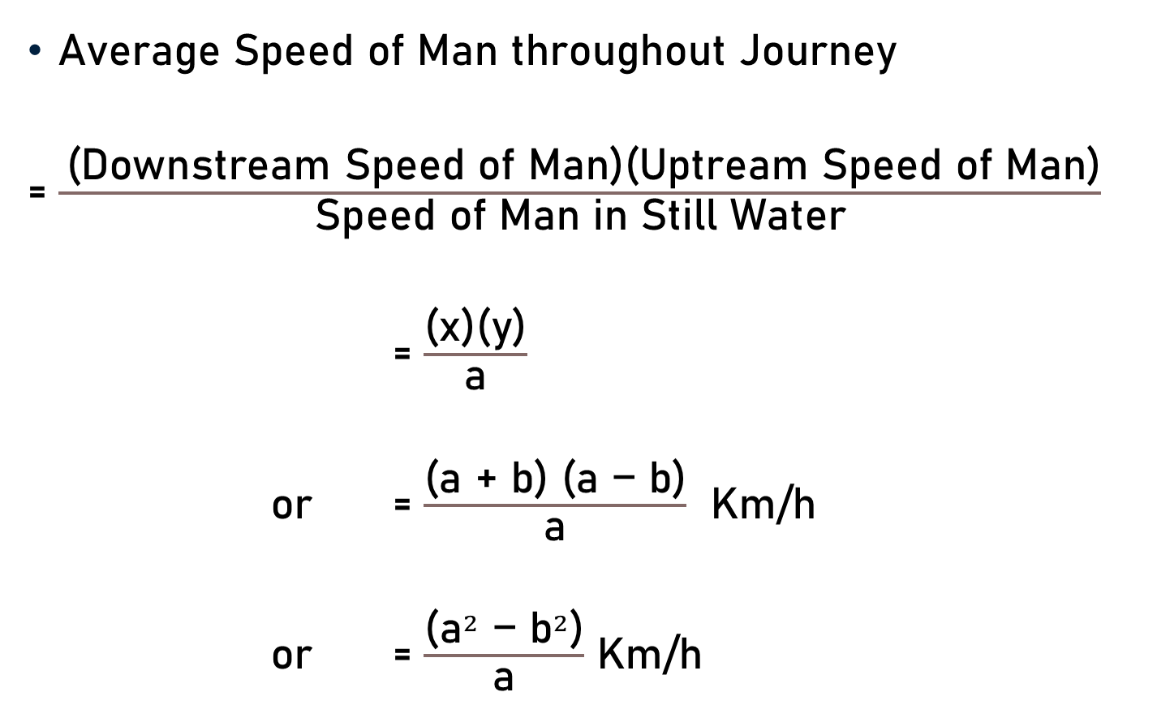
Important Facts & Formulae
Average Speed of Man throughout Journey
= $\frac{ \text{(}\text{Downstream} \text{Speed} \text{of} \text{Man}\text{)(}\text{Uptream} \text{Speed} \text{of} \text{Man}\text{)}}{\text{Speed} \text{of} \text{Man} \text{in} \text{S}\text{till} \text{W}\text{ater}}$
= $\frac{\text{(}\text{x}\text{)(}\text{y}\text{)}}{\text{a}}$
or = $\frac{\text{(}\text{a}\text{ + }\text{b}\text{) (}\text{a}\text{ − }\text{b}\text{)}}{\text{a}}$ Km/h
or = $\frac{\text{(}{\text{a}}^{2}\text{ − }{\text{b}}^{2}\text{)}}{\text{a}}$ Km/h

Slide 16
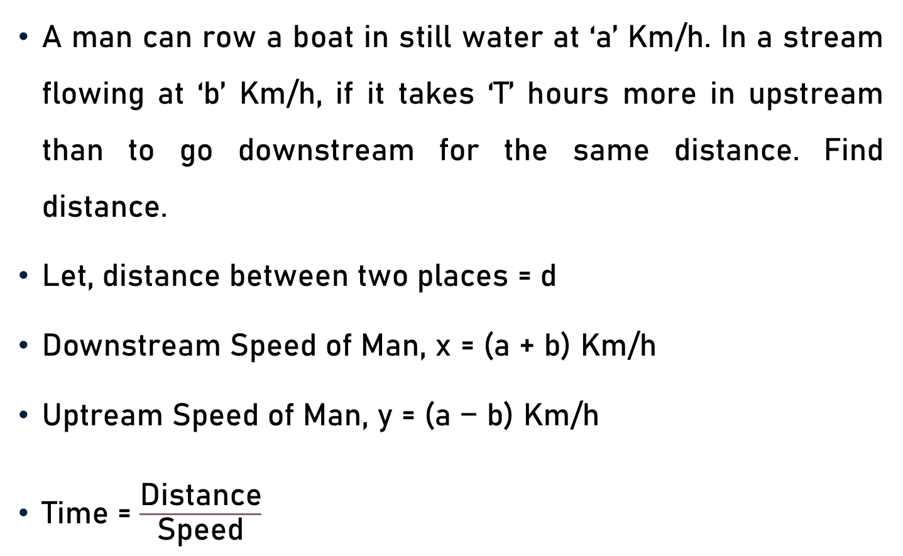
Important Facts & Formulae
A man can row a boat in still water at ‘a’ Km/h. In a stream flowing at ‘b’ Km/h, if it takes ‘T’ hours more in upstream than to go downstream for the same distance. Find distance.
$\text{Let}\text{, }\text{distance} \text{between} \text{two} \text{places}\text{ = }\text{d}$
$\text{Downstream} \text{Speed} \text{of} \text{Man}\text{, }\text{x}$ = $\text{(}\text{a}\text{ + }\text{b}\text{)}$ Km/h
$\text{Uptream} \text{Speed} \text{of} \text{Man}$, y = $\text{(}\text{a}\text{ − }\text{b}$) Km/h
Time = $\frac{\text{Distance}}{\text{Speed}}$

Slide 17
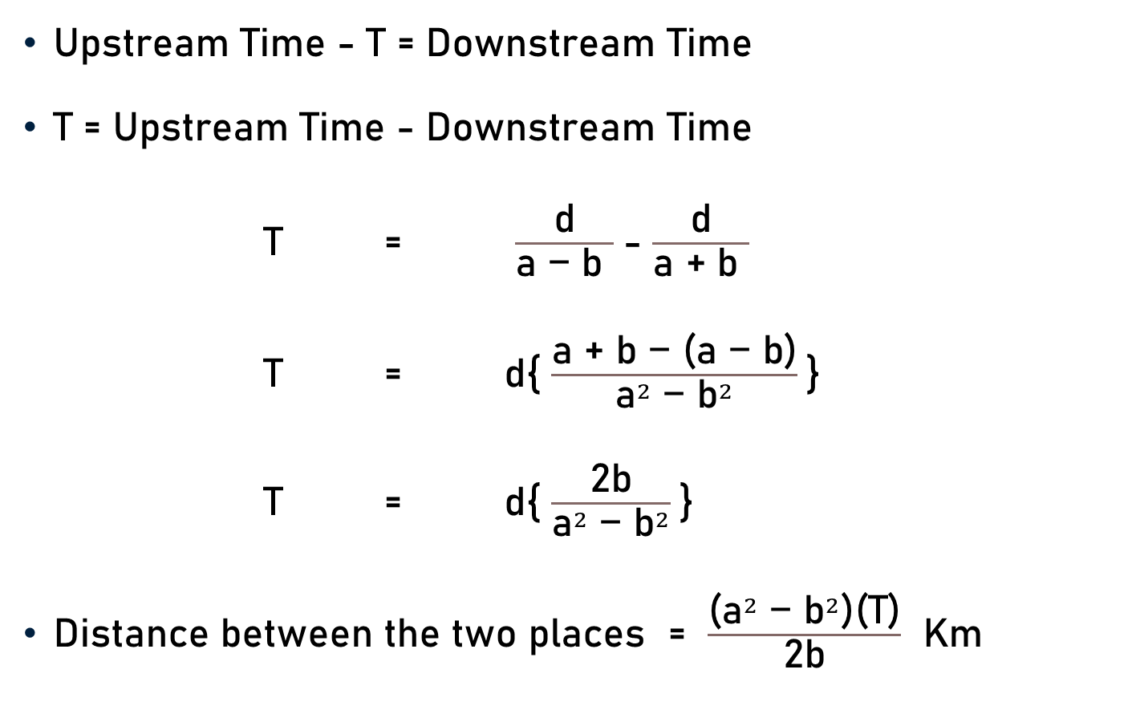
Important Facts & Formulae
Upstream Time - T = Downstream Time
T = Upstream Time - Downstream Time
T = $\frac{\text{d}}{\text{a}\text{ − }\text{b} }$- $\frac{\text{d}}{\text{a}\text{ + }\text{b} }$
T = $\text{d}${ $\frac{\text{a}\text{ + }\text{b} \text{− (}\text{a}\text{ − }\text{b}\text{)}}{{\text{a}}^{2} \text{−} {\text{b}}^{2}}$}
T = $\text{d}${ $\frac{\text{2}\text{b}}{{\text{a}}^{2}\text{ − }{\text{b}}^{2}}$}
Distance between the two places = $\frac{\text{(}{\text{a}}^{2} \text{−} {\text{b}}^{2}\text{)}\text{(}\text{T}\text{)}}{\text{2}\text{b}}$ Km

Slide 18
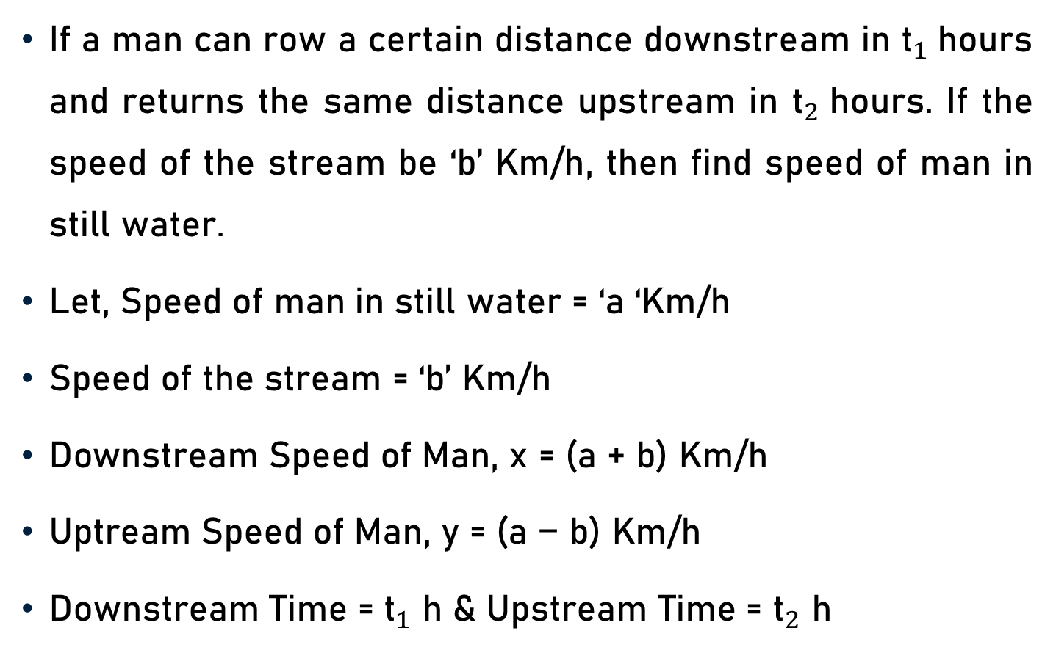
Important Facts & Formulae
If a man can row a certain distance downstream in ${\text{t}}_{1}$hours and returns the same distance upstream in ${\text{t}}_{2}$hours. If the speed of the stream be ‘b’ Km/h, then find speed of man in still water.
Let, Speed of man in still water = ‘a ‘Km/h
Speed of the stream = ‘b’ Km/h
$\text{Downstream} \text{Speed} \text{of} \text{Man}\text{, }\text{x}$ = $\text{(}\text{a}\text{ + }\text{b}\text{)}$ Km/h
$\text{Uptream} \text{Speed} \text{of} \text{Man}$, y = $\text{(}\text{a}\text{ − }\text{b}$) Km/h
Downstream Time = ${\text{t}}_{1}$ h & Upstream Time = ${\text{t}}_{2}$ h

Slide 19
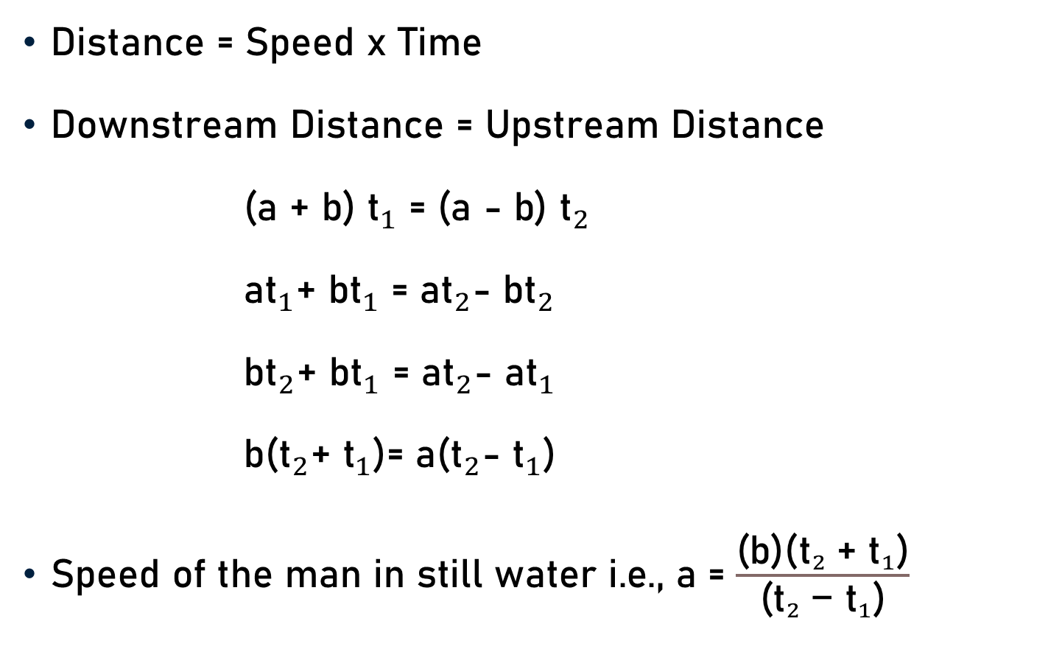
Important Facts & Formulae
Distance = Speed x Time
Downstream Distance = Upstream Distance
$\text{(}\text{a}\text{ + }\text{b}\text{)}$ ${\text{t}}_{1}$ = $\text{(}\text{a}\text{ − }\text{b}$) ${\text{t}}_{2}$
$\text{a}{\text{t}}_{1}\text{+ }\text{b}{\text{t}}_{1}$ = $\text{a}{\text{t}}_{2}\text{−} \text{b}{\text{t}}_{2}$
$\text{b}{\text{t}}_{2}\text{+ }\text{b}{\text{t}}_{1}$ = $\text{a}{\text{t}}_{2}\text{− }\text{a}{\text{t}}_{1}$
$\text{b}\text{(}{\text{t}}_{2}\text{+ }{\text{t}}_{1}\text{)}$= $\text{a}\text{(}{\text{t}}_{2}\text{−} {\text{t}}_{1}\text{)}$
$\text{Speed} \text{of} \text{the} \text{man} \text{in} \text{still} \text{water} \text{i}\text{.}\text{e}\text{., }\text{a}$= $\frac{\text{(}\text{b}\text{)(}{{\text{t}}_{2} \text{+ }\text{t}}_{1}\text{)}}{\text{(}{{\text{t}}_{2} \text{− }\text{t}}_{1}\text{)}}$

Slide 20
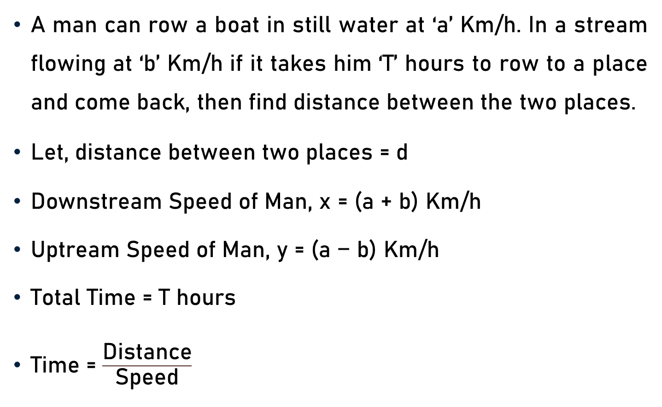
Important Facts & Formulae
A man can row a boat in still water at ‘a’ Km/h. In a stream flowing at ‘b’ Km/h if it takes him ‘T’ hours to row to a place and come back, then find distance between the two places.
$\text{Let}\text{, }\text{distance} \text{between} \text{two} \text{places}\text{ = }\text{d}$
$\text{Downstream} \text{Speed} \text{of} \text{Man}\text{, }\text{x}$ = $\text{(}\text{a}\text{ + }\text{b}\text{)}$ Km/h
$\text{Uptream} \text{Speed} \text{of} \text{Man}$, y = $\text{(}\text{a}\text{ − }\text{b}$) Km/h
Total Time = T hours
Time = $\frac{\text{Distance}}{\text{Speed}}$

Slide 21
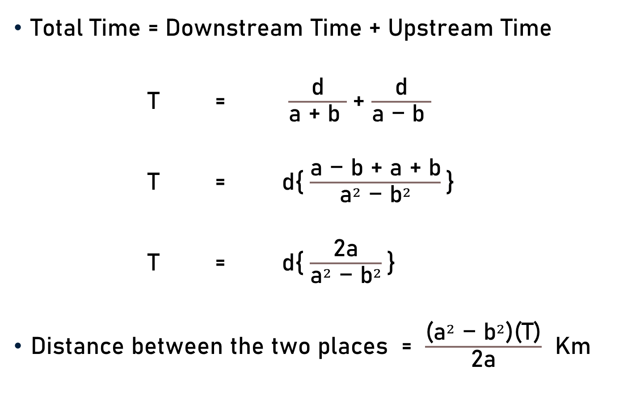
Important Facts & Formulae
Total Time = Downstream Time + Upstream Time
T = $\frac{\text{d}}{\text{a}\text{ + }\text{b} }$+ $\frac{\text{d}}{\text{a}\text{ − }\text{b} }$
T = $\text{d}${ $\frac{\text{a}\text{ − }\text{b} \text{+} \text{a}\text{ + }\text{b}}{{\text{a}}^{2} \text{−} {\text{b}}^{2}}$}
T = $\text{d}${ $\frac{\text{2}\text{a}}{{\text{a}}^{2}\text{ − }{\text{b}}^{2}}$}
Distance between the two places = $\frac{\text{(}{\text{a}}^{2} \text{−} {\text{b}}^{2}\text{)}\text{(}\text{T}\text{)}}{\text{2}\text{a}}$ Km

Slide 22
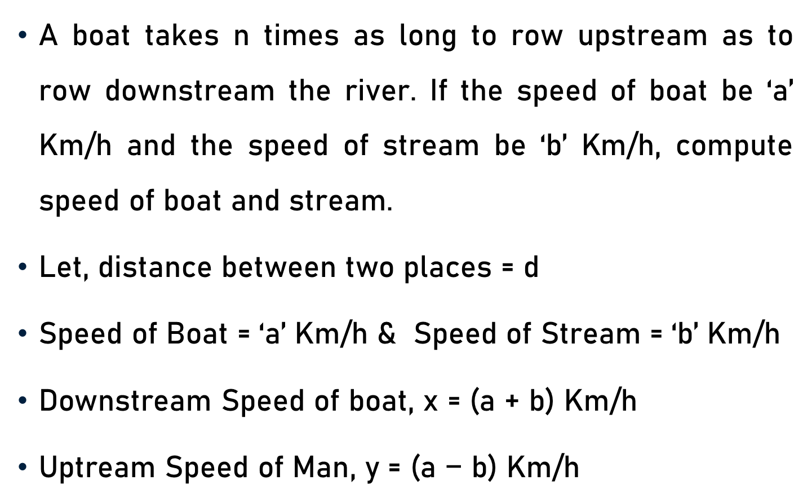
Important Facts & Formulae
A boat takes n times as long to row upstream as to row downstream the river. If the speed of boat be ‘a’ Km/h and the speed of stream be ‘b’ Km/h, compute speed of boat and stream.
$\text{Let}\text{, }\text{distance} \text{between} \text{two} \text{places}\text{ = }\text{d}$
Speed of Boat = ‘a’ Km/h & Speed of Stream = ‘b’ Km/h
$\text{Downstream} \text{Speed} \text{of} \text{boat}\text{, }\text{x}$ = $\text{(}\text{a}\text{ + }\text{b}\text{)}$ Km/h
$\text{Uptream} \text{Speed} \text{of} \text{Man}$, y = $\text{(}\text{a}\text{ − }\text{b}$) Km/h

Slide 23
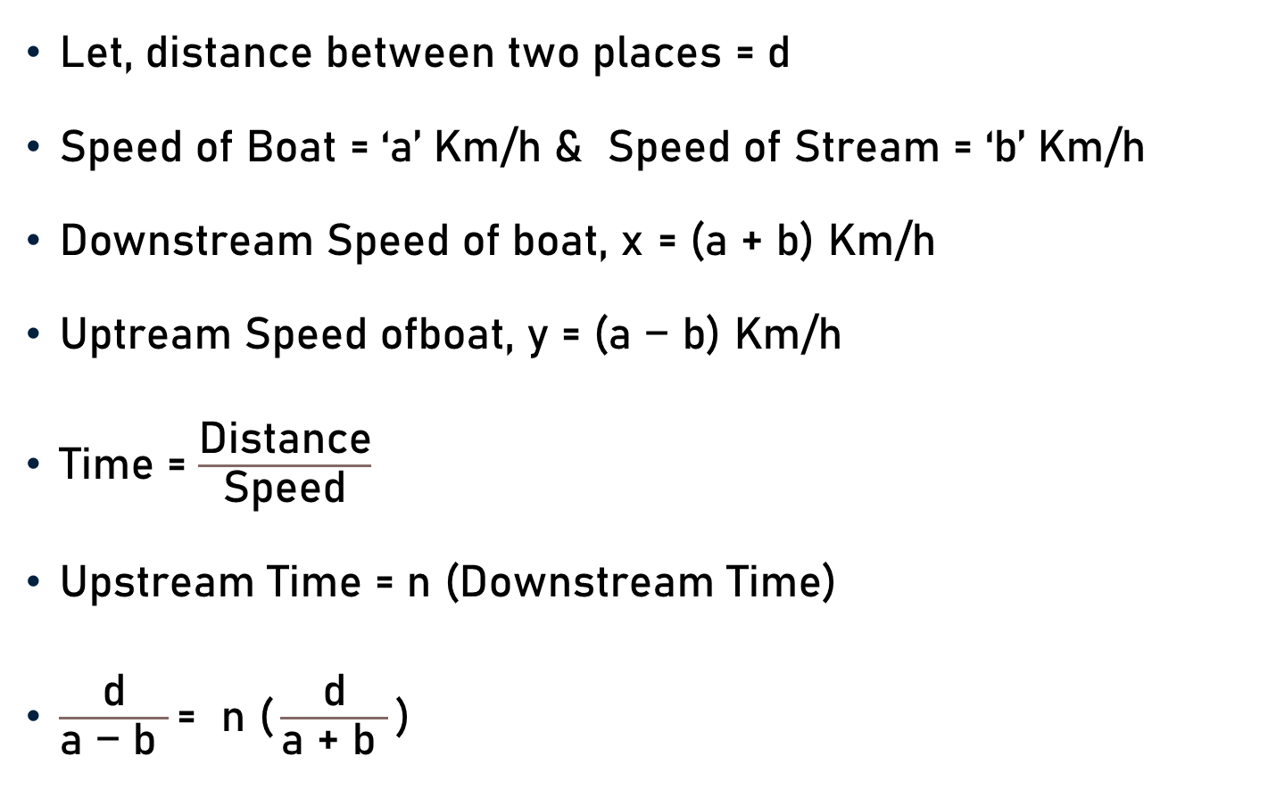
Important Facts & Formulae
$\text{Let}\text{, }\text{distance} \text{between} \text{two} \text{places}\text{ = }\text{d}$
Speed of Boat = ‘a’ Km/h & Speed of Stream = ‘b’ Km/h
$\text{Downstream} \text{Speed} \text{of} \text{boat}\text{, }\text{x}$ = $\text{(}\text{a}\text{ + }\text{b}\text{)}$ Km/h
$\text{Uptream} \text{Speed} \text{ofboat}$, y = $\text{(}\text{a}\text{ − }\text{b}$) Km/h
Time = $\frac{\text{Distance}}{\text{Speed}}$
Upstream Time = n (Downstream Time)
$\frac{\text{d}}{\text{a}\text{ − }\text{b} }\text{=} \text{n}\text{ (}\frac{\text{d}}{\text{a}\text{ + }\text{b} }\text{)}$

Slide 24

Important Facts & Formulae
$\frac{\text{d}}{\text{a}\text{ − }\text{b} }\text{=} \text{n}\text{ (}\frac{\text{d}}{\text{a}\text{ + }\text{b} }\text{)}$
$\text{a}\text{ + }\text{b} \text{=} \text{n}\text{ (}\text{a}\text{ − }\text{b}\text{)}$
$\text{a}\text{ + }\text{b} \text{=} \text{n}\text{a} \text{−} \text{n}\text{b}$
$\text{n}\text{b} \text{+ }\text{b} \text{=} \text{n}\text{a}\text{ −} \text{a}$
$\text{b}\text{(}\text{n}\text{ +}\text{ 1)} \text{=} \text{a}\text{(}\text{n}\text{ −} \text{1)}$
Speed of Boat i.e., a = $\frac{\text{b}\text{(}\text{n}\text{ + 1}\text{)}}{\text{(}\text{n}\text{ − 1}\text{)}}$

Slide 25

Important Facts & Formulae
$\frac{\text{d}}{\text{a}\text{ − }\text{b} }\text{=} \text{n}\text{ (}\frac{\text{d}}{\text{a}\text{ + }\text{b} }\text{)}$
$\text{a}\text{ + }\text{b} \text{=} \text{n}\text{ (}\text{a}\text{ − }\text{b}\text{)}$
$\text{a}\text{ + }\text{b} \text{=} \text{n}\text{a} \text{−} \text{n}\text{b}$
$\text{n}\text{b} \text{+ }\text{b} \text{=} \text{n}\text{a}\text{ −} \text{a}$
$\text{b}\text{(}\text{n}\text{ +}\text{ 1)} \text{=} \text{a}\text{(}\text{n} \text{−} \text{1)}$
Speed of Stream i.e., b = $\frac{\text{a}\text{(}\text{n}\text{ − 1}\text{)}}{\text{(}\text{n}\text{ + 1}\text{)}}$

Slide 26
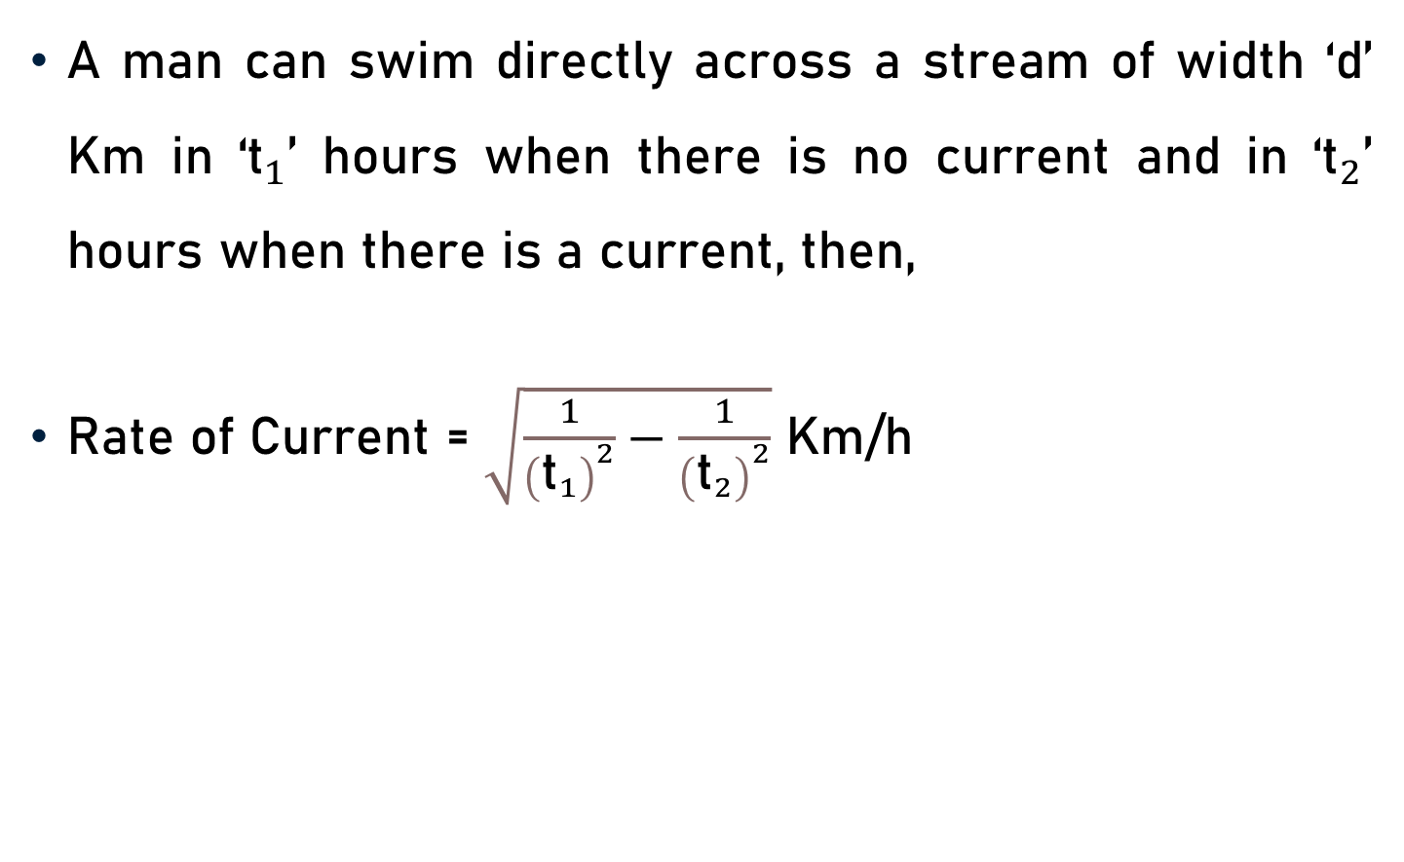
Important Facts & Formulae
A man can swim directly across a stream of width ‘d’ Km in ‘${\text{t}}_{1}$’ hours when there is no current and in ‘${\text{t}}_{2}$’ hours when there is a current, then,
Rate of Current = $\sqrt{\frac{1}{{\left({\text{t}}_{1}\right)}^{2}}−\frac{1}{{\left({\text{t}}_{2}\right)}^{2}}}$ Km/h

Slide 27
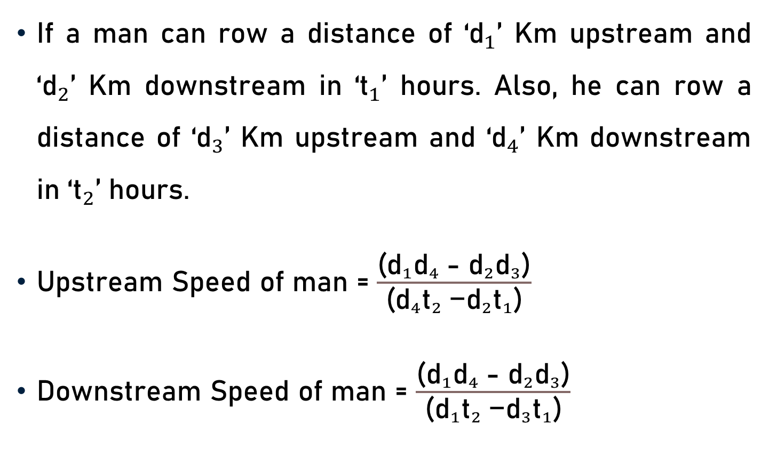
Important Facts & Formulae
If a man can row a distance of ‘${\text{d}}_{1}$’ Km upstream and ‘${\text{d}}_{2}$’ Km downstream in ‘${\text{t}}_{1}$’ hours. Also, he can row a distance of ‘${\text{d}}_{3}$’ Km upstream and ‘${\text{d}}_{4}$’ Km downstream in ‘${\text{t}}_{2}$’ hours.
Upstream Speed of man = $\frac{\text{(}{{{\text{d}}_{1}\text{d}}_{4} \text{− }{\text{d}}_{2}\text{d}}_{3}\text{)}}{\text{(}{{{\text{d}}_{4}\text{t}}_{2} \text{−}{\text{d}}_{2}\text{t}}_{1}\text{)}}$
Downstream Speed of man = $\frac{\text{(}{{{\text{d}}_{1}\text{d}}_{4} \text{− }{\text{d}}_{2}\text{d}}_{3}\text{)}}{\text{(}{{{\text{d}}_{1}\text{t}}_{2} \text{−}{\text{d}}_{3}\text{t}}_{1}\text{)}}$

Slide 28
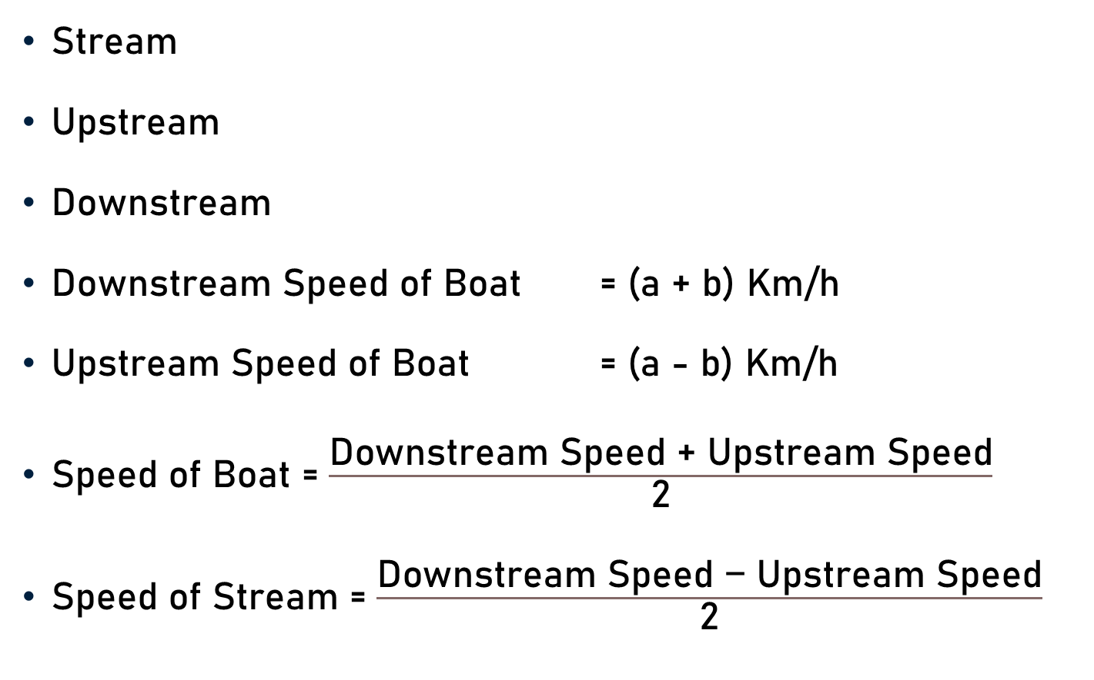
Conclusion
Stream
Upstream
Downstream
Downstream Speed of Boat = (a + b) Km/h
Upstream Speed of Boat = (a - b) Km/h
Speed of Boat = $\frac{\text{Downstream} \text{Speed}\text{ + }\text{Upstream} \text{Speed}}{\text{2}}$
Speed of Stream = $\frac{\text{Downstream} \text{Speed}\text{ − }\text{Upstream} \text{Speed}}{\text{2}}$

Slide 29
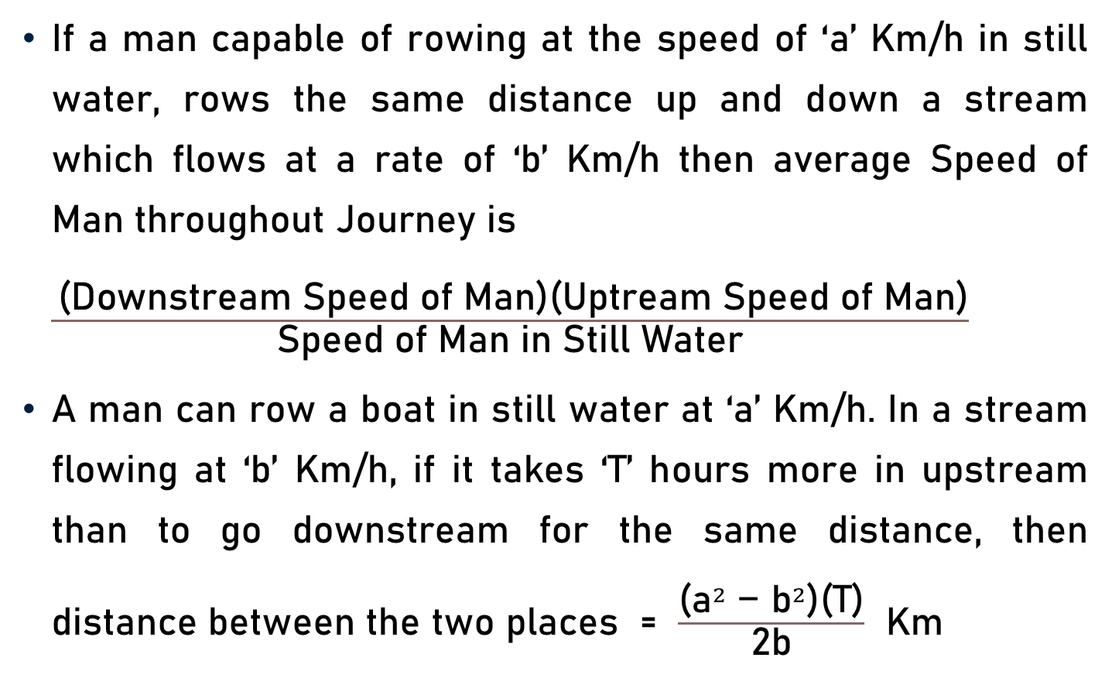
Conclusion
If a man capable of rowing at the speed of ‘a’ Km/h in still water, rows the same distance up and down a stream which flows at a rate of ‘b’ Km/h then average Speed of Man throughout Journey is $\frac{ \text{(}\text{Downstream} \text{Speed} \text{of} \text{Man}\text{)(}\text{Uptream} \text{Speed} \text{of} \text{Man}\text{)}}{\text{Speed} \text{of} \text{Man} \text{in} \text{Still} \text{Water}}$
A man can row a boat in still water at ‘a’ Km/h. In a stream flowing at ‘b’ Km/h, if it takes ‘T’ hours more in upstream than to go downstream for the same distance, then distance between the two places = $\frac{\text{(}{\text{a}}^{2}\text{ − }{\text{b}}^{2}\text{)}\text{(}\text{T}\text{)}}{\text{2}\text{b}}$ Km

Slide 30
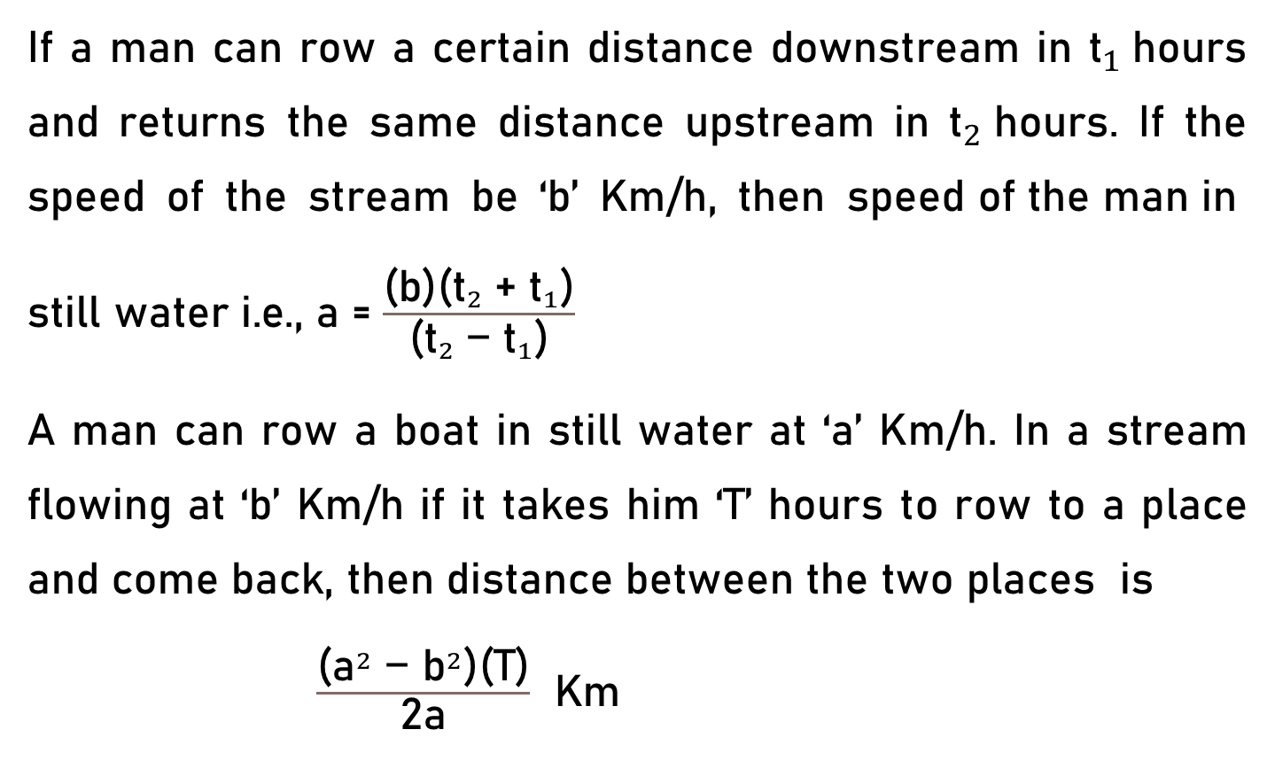
Conclusion
If a man can row a certain distance downstream in ${\text{t}}_{1}$hours and returns the same distance upstream in ${\text{t}}_{2}$hours. If the speed of the stream be ‘b’ Km/h, then $\text{s}\text{peed} \text{of} \text{the} \text{man} \text{in} \text{still} \text{water} \text{i}\text{.}\text{e}\text{., }\text{a}$= $\frac{\text{(}\text{b}\text{)(}{{\text{t}}_{2} \text{+ }\text{t}}_{1}\text{)}}{\text{(}{{\text{t}}_{2} \text{− }\text{t}}_{1}\text{)}}$
A man can row a boat in still water at ‘a’ Km/h. In a stream flowing at ‘b’ Km/h if it takes him ‘T’ hours to row to a place and come back, then distance between the two places is $\frac{\text{(}{\text{a}}^{2}\text{ − }{\text{b}}^{2}\text{)}\text{(}\text{T}\text{)}}{\text{2}\text{a}}$ Km

Slide 31
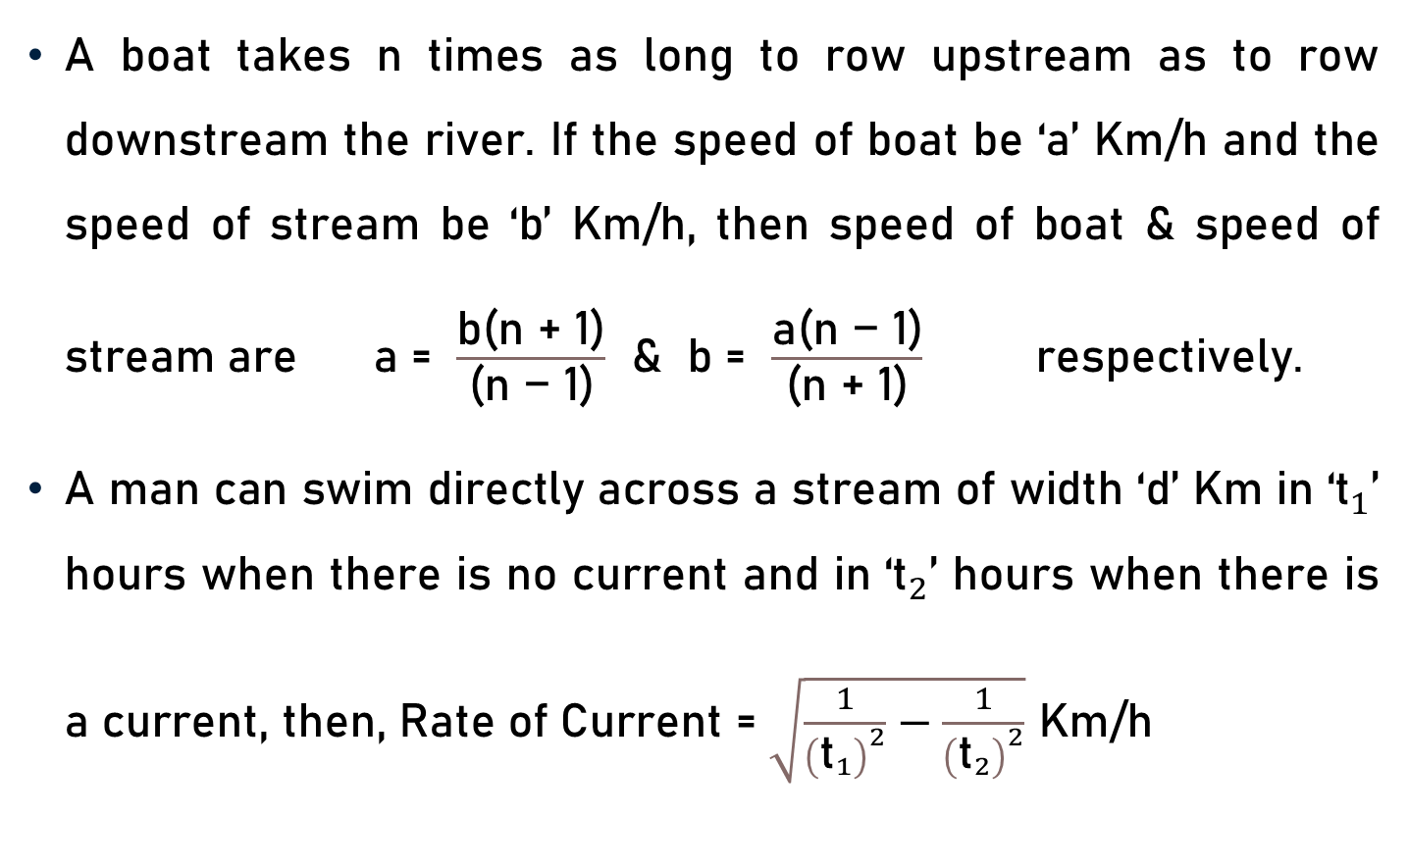
Conclusion
A boat takes n times as long to row upstream as to row downstream the river. If the speed of boat be ‘a’ Km/h and the speed of stream be ‘b’ Km/h, then speed of boat & speed of stream are a = $\frac{\text{b}\text{(}\text{n}\text{ + 1}\text{)}}{\text{(}\text{n}\text{ − 1}\text{)}}$ & b = $\frac{\text{a}\text{(}\text{n}\text{ − 1}\text{)}}{\text{(}\text{n}\text{ + 1}\text{)}}$ respectively.
A man can swim directly across a stream of width ‘d’ Km in ‘${\text{t}}_{1}$’ hours when there is no current and in ‘${\text{t}}_{2}$’ hours when there is a current, then, Rate of Current = $\sqrt{\frac{1}{{\left({\text{t}}_{1}\right)}^{2}}−\frac{1}{{\left({\text{t}}_{2}\right)}^{2}}}$ Km/h

Slide 32
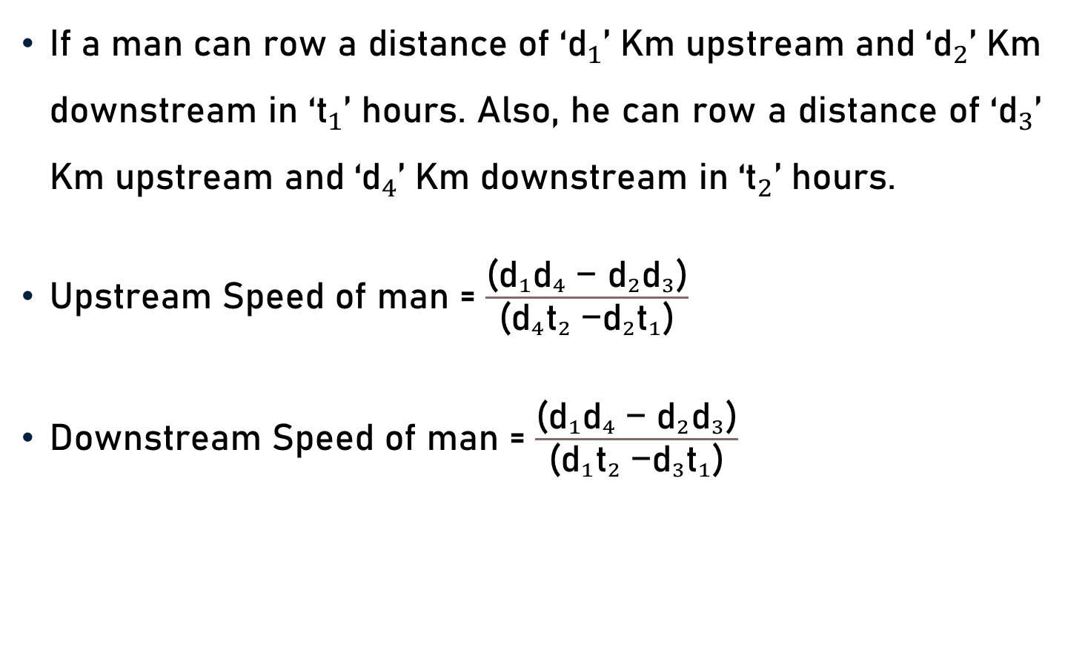
Conclusion
If a man can row a distance of ‘${\text{d}}_{1}$’ Km upstream and ‘${\text{d}}_{2}$’ Km downstream in ‘${\text{t}}_{1}$’ hours. Also, he can row a distance of ‘${\text{d}}_{3}$’ Km upstream and ‘${\text{d}}_{4}$’ Km downstream in ‘${\text{t}}_{2}$’ hours.
Upstream Speed of man = $\frac{\text{(}{{{\text{d}}_{1}\text{d}}_{4} \text{− }{\text{d}}_{2}\text{d}}_{3}\text{)}}{\text{(}{{{\text{d}}_{4}\text{t}}_{2} \text{−}{\text{d}}_{2}\text{t}}_{1}\text{)}}$
Downstream Speed of man = $\frac{\text{(}{{{\text{d}}_{1}\text{d}}_{4} \text{− }{\text{d}}_{2}\text{d}}_{3}\text{)}}{\text{(}{{{\text{d}}_{1}\text{t}}_{2} \text{−}{\text{d}}_{3}\text{t}}_{1}\text{)}}$

Slide 33
Summary
Basics
  Stream, Upstream & Downstream
Important Facts & Formulae
  Boats & Streams

